Slide 1
Microservices Design Exercise

Slide 2
Outline
Objectives
On completing this module, you will be able to:
Design a microservices architecture for a given scenario
Explain pros and cons of the design
Topics
MSA design

Slide 3
Business Requirements
Read the Mini Case: Bookstore Scenario
Draw design diagrams

Slide 4
Sample overall scenarios in this bookstore
User scenarios
Browse books in the bookstore
Place an order for a book
Likely need two UI pages, one for browsing, the other for placing an order, although they can be linked in some way (e.g., via a hyperlink or a click button)
(Data) Entities
Book
Order
Shipping Record
Activity Log
Error
Customer
…
Notes:
In relation to the term "use cases" in BPAS, you may think of a user scenario as a use case with a human actor.
Beyond the course scope:
A user scenario is related to a user story, where the scenario describes in more details what users do to accomplish a user story; e.g., a user can browse books on the bookstore homepage is a user story, while a more detailed description is a user scenario, e.g. a user goes to the bookstore homepage, and the homepage will retrieve all available books and display them to the user.
A collection of user stories for the same kind of users is a user persona for that kind of users.

Slide 5
Example: Monolithic Bookstore Application
Bookstore App (monolith)
Tables:
book
order
order_item
customer
cart
cart_item
……
UI
Logic
bookstore
Notes:
All functionalities in the monolith are implemented in the same language, and interactions happen via function calls in the language.
All data entities are stores in various tables in the same database.

Slide 6
Example: Bookstore Monolith Decomposed
Table:
book
Book
book
UI
Tables:
order
order_item
Order
order
Shipping Record
Activity Log
Error
customer
Table:
customer
Customer
Tables:
cart
cart_item
Shopping Cart
cart
Micro-service logic
database
table(s) in the db
optional functionalities
Legends:
Notes:
For simplicity in the initial implementation, we may not implement Customer, Shopping Cart in the labs.

Slide 7

Example: Microservice Interaction Diagram – A customer browses books in the bookstore
Book
1. Get all books
2. Return a list of books
Amazing Bookstore UI
Browse books
Browse books by visiting the bookstore homepage
Legend
Micro-service
Customer
External service
Notes:
In industry, there can be variants in the names for such a diagram, e.g., user scenario diagram; there can be variants in drawing the diagram in different styles with different amounts of details.
The key purpose of such diagrams is to show the interactions & data flows among microservices and UIs.

Slide 8
Technical Overview Diagram
UI Names
Menu Items
Amazing Bookstore UI
Browse books
?
Communication Technology
HTTP
Micro-service Names
Book
Book
Database / Storage Names
?
?
?
?

Slide 9
Discussion
Pros and cons of this decomposed design versus the monolithic design
Hint: why do we use microservices instead of monoliths? Think of an enterprise that needs to change its business functions, processes, products/services from time to time.

Slide 10
Discussion
Are there clear SOA layers in this microservices design?
Hint: where are the components or microservices in this design that implement the business processes (user scenarios)? Which component controls the workflow of the business process?
Hint: should a business process be in the same layer as that of its constituent components or microservices?
Notes:
"workflow" can be depicted as a sequence of operations following a business process; it determines the order in which the operations in a business process are performed.

Slide 11

Choreography as an architectural design pattern
Implementation of a workflow or business process is a composition of services that collaborate in a distributed manner without a single-point of control
Each service performs its own functions without knowing others, but may need to know the data passed through the workflow, in order to process the right data correctly
The workflow or business process is completed collectively by more than one service
Notes:
Who's the choreographer? It's usually unknown by just looking at the dance scene.
Individual performers do their own actions, as long as they don’t clash into each other, and collectively complete the dance scene.
Image source: https://dance-insight.com/write-down-choreography/

Slide 12
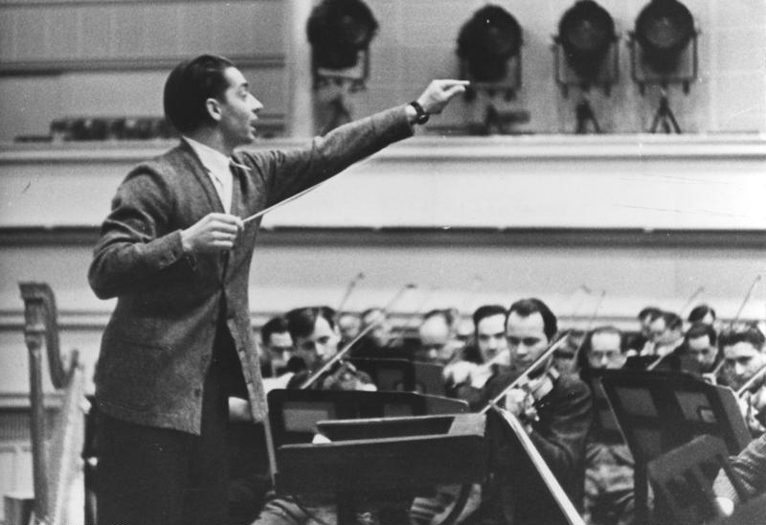
Orchestration as an architectural design pattern
Implementation of a workflow or business process is a composition of services in a single-point of control
There is a service (i.e., the controller) controlling the workflow
Each service, except for the controller, performs its own functions without knowing others
The controller need to know all the other services controlled by it, and pass right data to the right services for processing
Notes:
Who's the conductor/orchestrator? It's usually clear by just looking at the scene.
The conductor should know all the performers’ status and give clear instructions to the performers, and control the scene.
Individual performers watch out for the conductor’s instructions and do their own actions; it's not needed for them to know other performers, except for the conductor.
Image source: https://en.wikipedia.org/wiki/Conducting

Slide 13
Choreographic versus Orchestrated Patterns
Choreographic architectural pattern
No clear central controller of a business process
Microservices can react to any data or event received without knowing who is the sender, and send out data without knowing who is the receiver
Distributed coordination among microservices
Orchestrated architectural pattern
A central controller, often a composite microservice, exists in a business process
The controller interacts with other microservices to complete a business process
Centralized coordination among microservices

Slide 14
API Docs
Provide a reference to all the APIs available from all the (micro)services in an enterprise solution
Define the standard application programming interfaces to the services, including the data formats used, communication technologies used, service names, etc.
Every service consumer can look at the documents and know how to use the services, without the need of knowing the internal implementation of the services
Sample docs for the APIs of our bookstore microservices are available at: https://docs.google.com/document/d/1OhFVVvuHgeNcQ-BFsM-m2ST6vhV3YISDbkp4y8PIV-Q/edit?usp=sharing

